Slide 1
Forecasting energy demand Hamessing IOT Data for smart grid Analytics
By
Kotha Aswitha
Challa Yashwitha
Akili Veera Padma Aravinda Rao
Godasi Chandrakanth

Slide 2
Outline:
Motivation
Introduction
Objectives
Code
Outputs
Conclusions

Slide 3
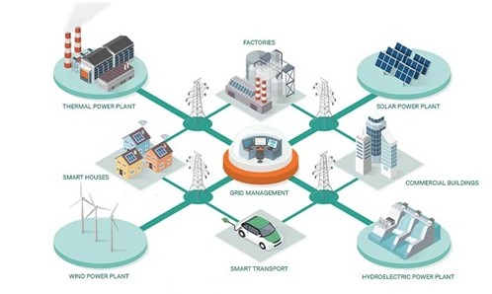
Motivation:
Forecasting energy demand through IoT data analytics for smart grid applications holds immense promise for revolutionizing the energy sector. By leveraging real-time data from interconnected devices, utility companies can optimize energy distribution, enhance grid stability, and implement demand response programs effectively. This not only improves operational efficiency and cost savings but also facilitates the seamless integration of renewable energy sources into the grid. Furthermore, IoT-enabled analytics empower consumers with insights into their energy usage, encouraging greater engagement in energy-saving practices

Slide 4
Introduction:
Global energy demand is on the rise due to factors like urbanization and industrial growth.
The advent of IoT technology has revolutionized data collection and connectivity, offering opportunities for optimizing energy systems.
Smart grid evolution leverages IoT data and analytics to create dynamic, interconnected energy grids.
Accurate forecasting of energy demand is essential for grid reliability, cost reduction, and regulatory compliance.
IoT data streams from smart meters, sensors, and weather forecasts enable sophisticated demand forecasting models.
Motivations behind IoT-driven demand forecasting include optimizing energy distribution, enhancing grid stability, integrating renewables, engaging consumers, enabling predictive maintenance, ensuring regulatory compliance, and fostering innovation.
This paper explores the significance, benefits, challenges, and potential applications of IoT-driven energy demand forecasting for smart grid analytics.

Slide 5
Literature Review:
forecasting energy demand through IoT data analytics for smart grid applications highlights the diverse methodologies and applications within this field. Researchers have explored various statistical and machine learning techniques to improve the accuracy of demand forecasts, leveraging data from smart meters, sensors, weather forecasts, and social media.
Accurate demand forecasting not only enhances grid optimization and stability but also facilitates the integration of renewable energy sources and empowers utilities to engage consumers in energy-saving practices. Furthermore, IoT-enabled analytics enable predictive maintenance of grid infrastructure, reducing downtime and improving asset management. As utilities strive to meet regulatory requirements and policy goals, IoT-driven demand forecasting emerges as a pivotal tool for shaping the future of energy management and sustainability.

Slide 6
Objectives:
Improve grid stability by accurately predicting energy demand fluctuations.
Optimize resource allocation across generation, transmission, and distribution to minimize wastage and operational costs.
Facilitate seamless integration of renewable energy sources by forecasting their output and aligning with demand patterns.
Engage consumers with insights into energy usage, fostering informed decisions and participation in energy-saving initiatives.
Implement predictive maintenance strategies to enhance grid reliability and minimize downtime through real-time infrastructure monitoring.

Slide 7
Code:
import streamlit as st
import pandas as pd
import numpy as np
from sklearn.ensemble import RandomForestRegressor, GradientBoostingRegressor
from sklearn.linear_model import LinearRegression
import matplotlib.pyplot as plt
@st.cache
def load_data(file_path):
data = pd.read_csv(file_path)
return data
def train_model(algorithm, X_train, y_train):

Slide 8
if algorithm == 'Random Forest':
model = RandomForestRegressor()
elif algorithm == 'Gradient Boosting':
model = GradientBoostingRegressor()
elif algorithm == 'Linear Regression':
model = LinearRegression()
else:
raise ValueError("Invalid algorithm selected")
model.fit(X_train, y_train)
return model
def predict(model, X_test):
return model.predict(X_test)

Slide 9
def main():
st.title('Energy Demand Forecasting with IoT Data')
algorithm = st.sidebar.selectbox('Select Algorithm', ['Random Forest', 'Gradient Boosting', 'Linear Regression'])
file_path = st.sidebar.file_uploader('Upload IoT Data', type=['csv'])
if file_path:
data = load_data(file_path)
data = preprocess_data(data)
st.subheader('Loaded Data')
st.write(data)
X = data.drop(columns=['serial', 'Time_stamp','kVAR'])
y = data['kVAR']

Slide 10
model = train_model(algorithm, X, y)
st.subheader('Predict on Test Dataset')
serial = st.number_input('Serial', value=0)
kWh = st.number_input('kWh', value=0.000 )
kW = st.number_input('kW', value=0.000)
kVARh = st.number_input('kVARh', value=0.000)
if st.button('Predict'):
test_data = pd.DataFrame({'serial': [serial], 'kWh': [kWh], 'kW': [kW], 'kVARh':[kVARh]})
test_X = test_data.drop(columns=['serial’])
prediction = predict(model, test_X)
st.subheader('Prediction’)
st.write(prediction)

Slide 11
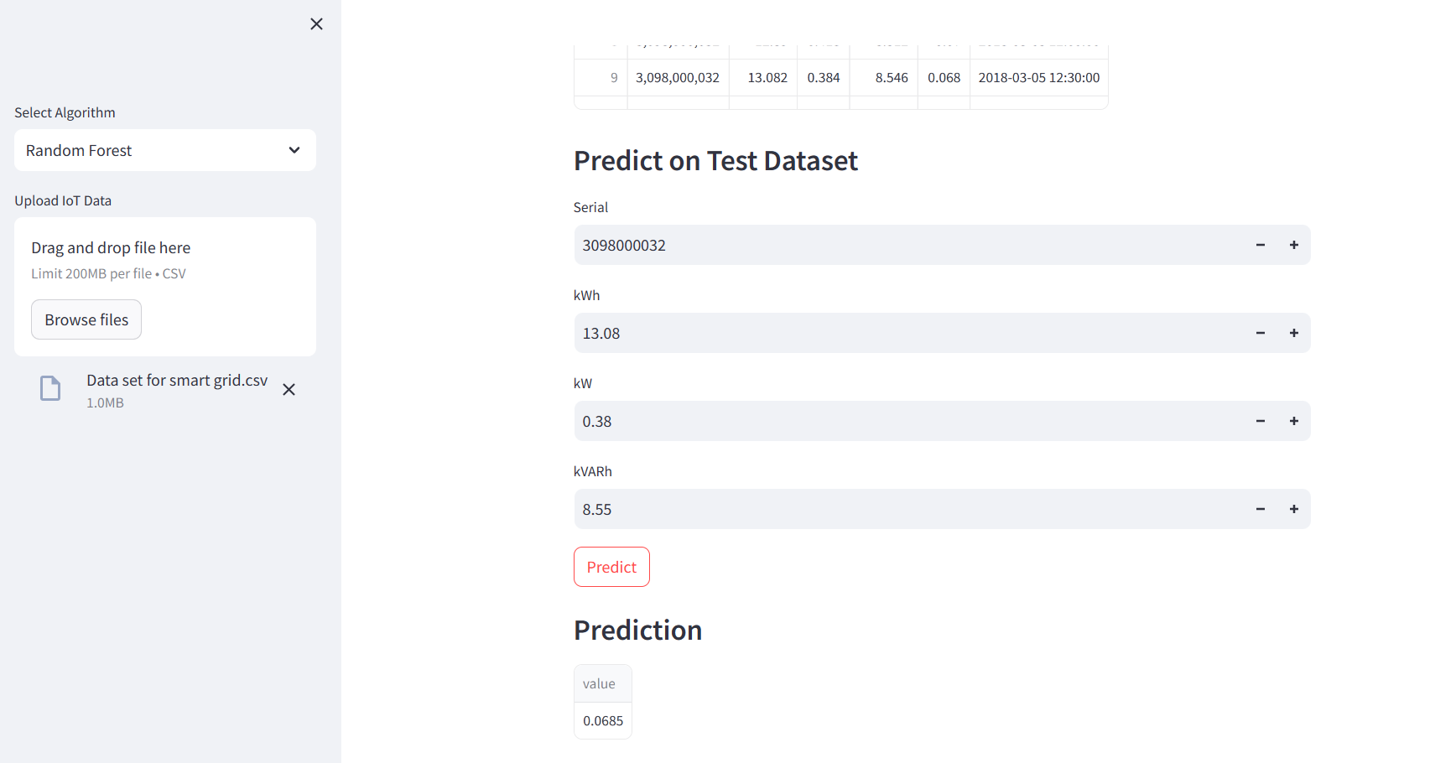
Output:

Slide 12
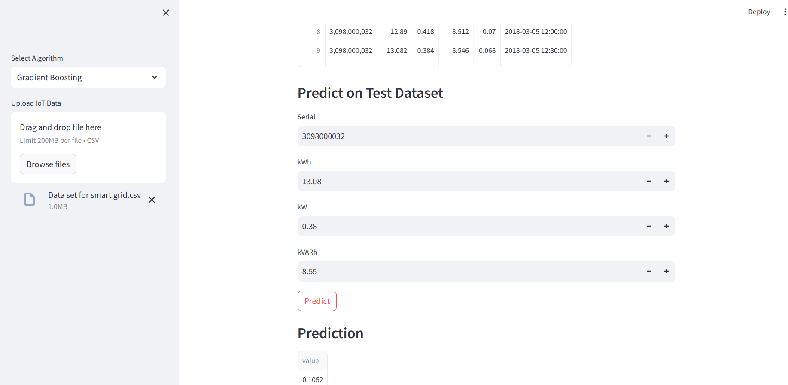

Slide 13
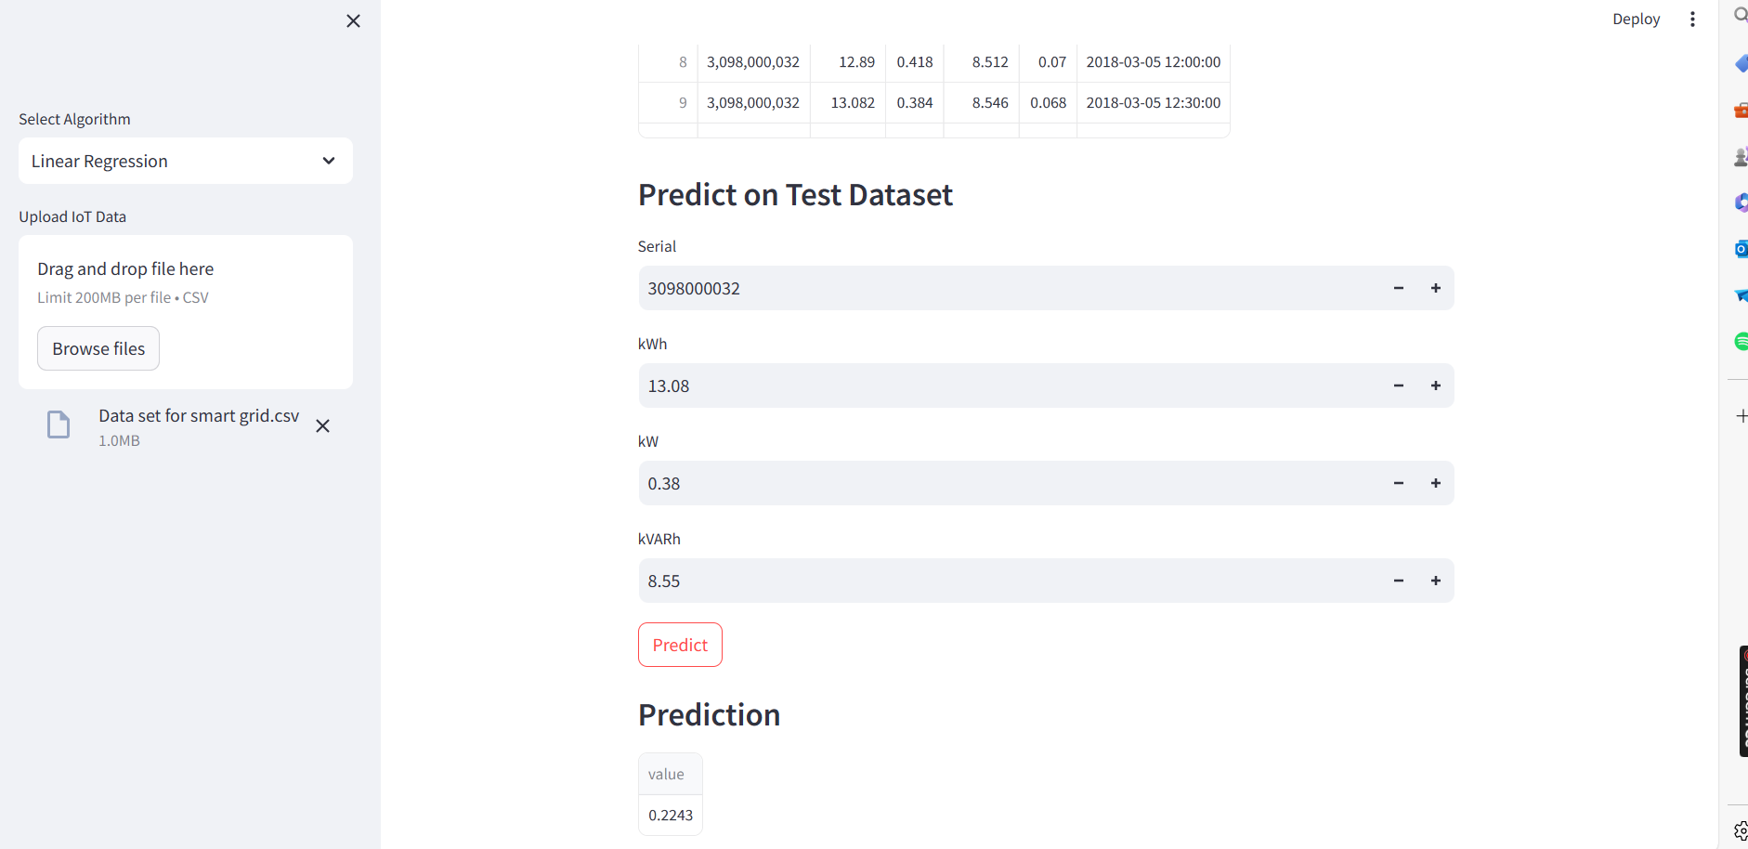

Slide 14
Conclusions:
IoT-enabled data analytics offers valuable insights for forecasting energy demand, enabling utilities to optimize grid operations and enhance efficiency.
Accurate demand forecasting supports the integration of renewable energy sources, contributing to a more sustainable energy infrastructure.
Engaging consumers through personalized insights encourages energy-saving behaviors and promotes active participation in demand-side management.
Predictive maintenance strategies improve grid reliability and reduce maintenance costs by anticipating equipment failures and optimizing maintenance schedules.
Leveraging IoT data analytics for smart grid applications not only meets regulatory requirements but also fosters innovation and drives the transition towards a more resilient and sustainable energy future.

Slide 15
Any Questions/Discussions ???

Slide 16
Thank You !!!

